Slide 1
Context-Free Languages

Slide 2
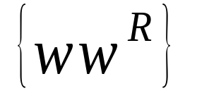
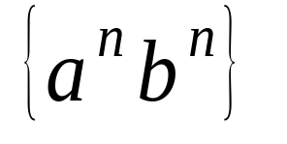
Regular Languages

Slide 3
Context-Free Languages
Regular Languages

Slide 4
Context-Free Languages
Context-Free
Grammars
Pushdown
Automata

Slide 5
Context-Free Grammars

Slide 6
Definition
A context-free grammar G=(V,T,P,S), where:
V: set of variables or non-terminals (also use N)
T: set of terminals (alphabet U { ε })
P: set of productions, each of which is of the form
V → α 1 | α 2 | … Where each α i is an arbitrary string of variables and terminals
S: start variable which is an element in V

Slide 7
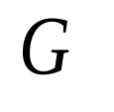
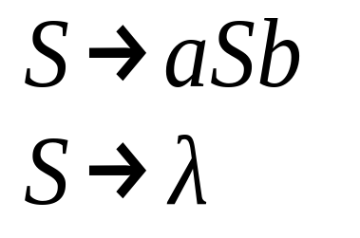
Example
A context-free grammar :
A derivation:
Another derivation:

Slide 8
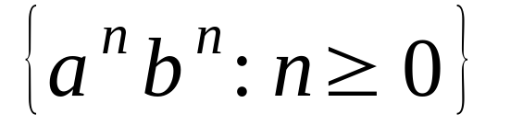
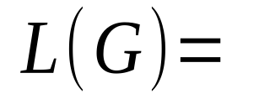
This language can be
used to check (((( ))))

Slide 9
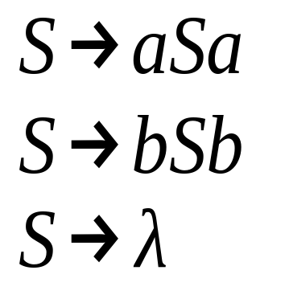
Example
A context-free grammar :
A derivation:
Another derivation:
L = {ww^{R}| w ∈ {a,b}*}

Slide 10
<sentence> → <noun phrase> <verb phrase>
S → NP VP
NP → ADJ NP | ADJ SN
VP → SV ADV
ADJ → a| the | little
SN → boy
SV → ran
ADV → quickly

Slide 11
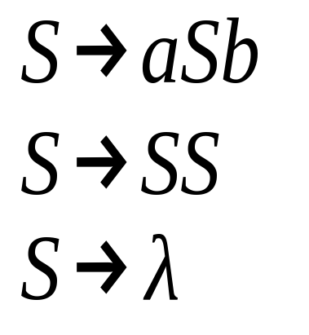
Example
A context-free grammar :
A derivation:
Another derivation:

Slide 12
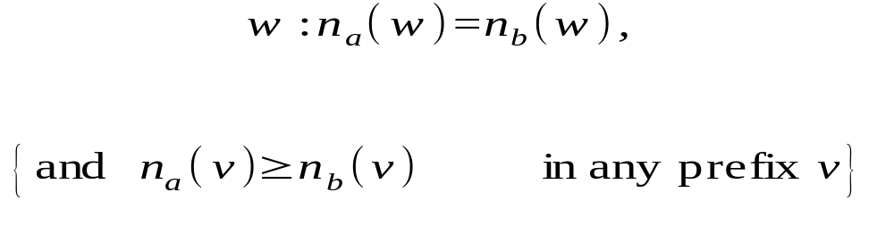
() ((( ))) (( ))

Slide 13
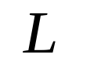
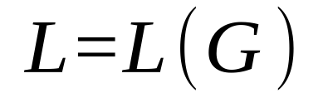
Definition: Context-Free Languages
A language is context-free
if and only if
there is a grammar with

Slide 14
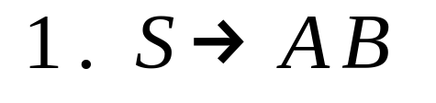
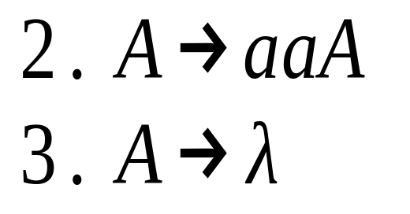
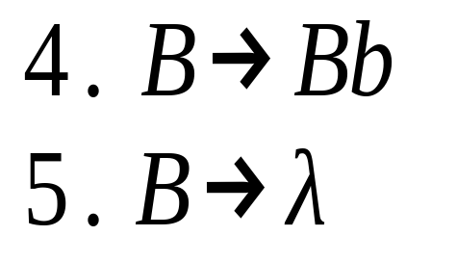
Derivation Order

Slide 15
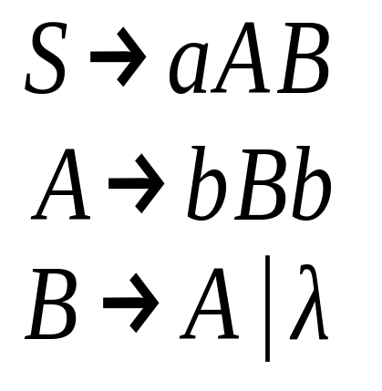
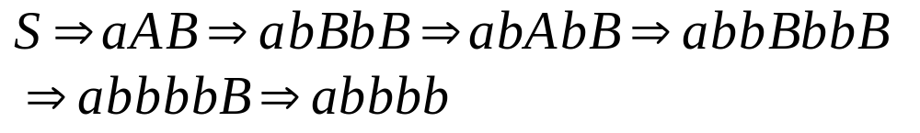
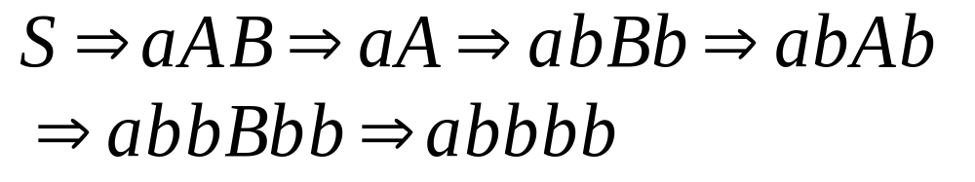
Leftmost derivation:
Rightmost derivation:

Slide 16
Derivation Trees

Slide 17

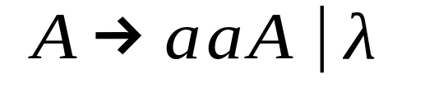
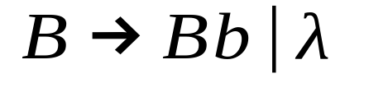





Slide 18



Slide 19


Slide 20


Slide 21
Derivation Tree

Slide 22
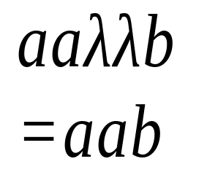
Derivation Tree
yield

Slide 23
Partial Derivation Trees
Partial derivation tree

Slide 24
Partial derivation tree

Slide 25

sentential
form
Partial derivation tree
yield

Slide 26
Sometimes, derivation order doesn’t matter
Leftmost:
Rightmost:
Same derivation tree

Slide 27
Ambiguity

Slide 28

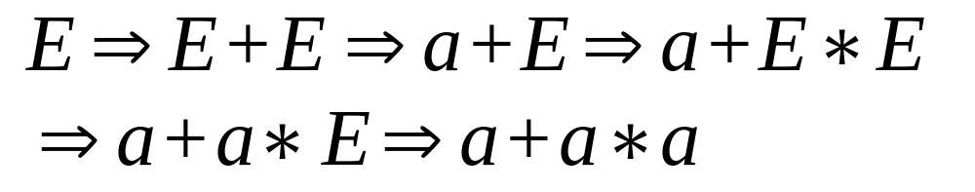


leftmost derivation

Slide 29
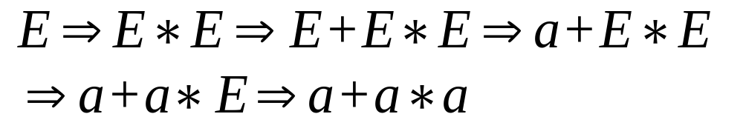
leftmost derivation

Slide 30
Two derivation trees

Slide 31
The grammar
is ambiguous:
string
has two derivation trees

Slide 32
The grammar
is ambiguous:
string
has two leftmost derivations

Slide 33
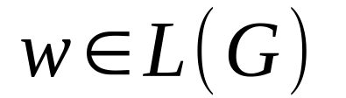
Definition:
A context-free grammar is ambiguous
if some string has:
two or more derivation trees

Slide 34
In other words:
A context-free grammar is ambiguous
if some string has:
two or more leftmost derivations
(or rightmost)

Slide 35

Why do we care about ambiguity?
take

Slide 36



Slide 37






Slide 38
Correct result:

Slide 39
Ambiguity is bad for programming
languages
We want to remove ambiguity

Slide 40
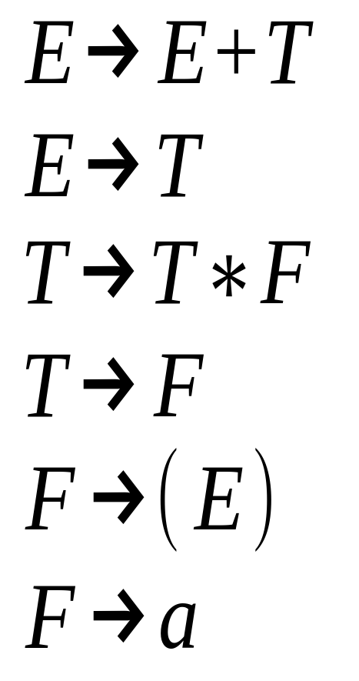
We fix the ambiguous grammar
by considering precedence
New non-ambiguous
grammar:

Slide 41
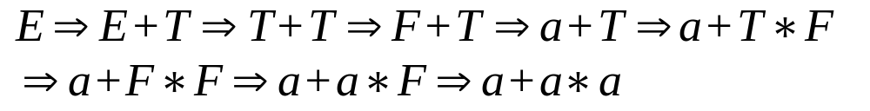



Slide 42
Unique derivation tree

Slide 43
The grammar :
is non-ambiguous:
Every string has
a unique derivation tree

Slide 44
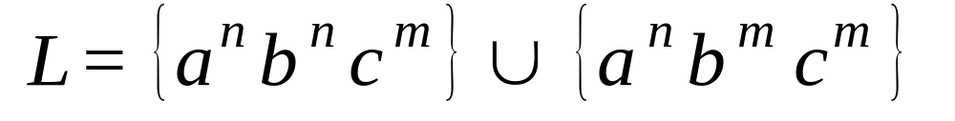
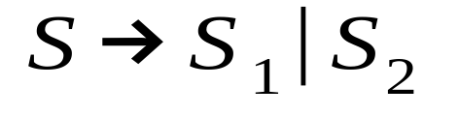
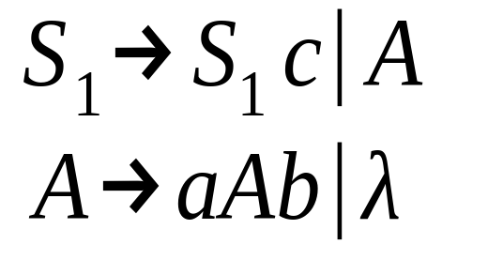
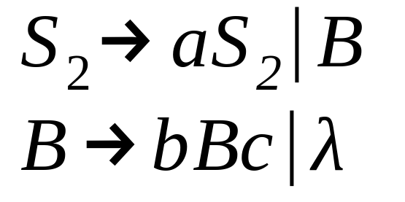
Inherent Ambiguity
Some context free languages
have only ambiguous grammars
Example:

Slide 45
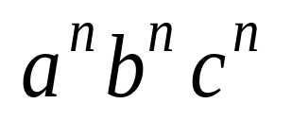



The string
has two derivation trees

Slide 46
CFG Simplification
Eliminate ambiguity.
Eliminate “useless” variables.
Eliminate ε-productions: A→ε.
Eliminate unit productions: A→B.
Eliminate redundant productions.
Trade left- & right-recursion.

Slide 47
Normal forms for Context-Free Grammars
A number of simplifications is inevitable:
The elimination of useless symbols, “variables or terminals that do not appear in any derivation of a terminal string from the start symbol”.
The elimination of ε-productions, those of the form A → ε for some variable A.
The elimination of unit productions, those of the form A → B for variables A and B.

Slide 48
Eliminating useless symbols
A symbol X is useful for Grammar G = {V, T, P, S}, if there is some derivation of the form S ═>* a X b ═>* w , where w є T*
X є V or X є T
The sentential form of a X b might be the first or last derivation
If X is not useful, then X is useless

Slide 49
Eliminating useless symbols
Characteristics of useful symbols (for instance X):
X is generating if X ═>* w for some terminal string w. Every terminal is generating since w can be that terminal itself, which is derived by 0 steps.
X is reachable if there is a derivation
S ═>* a X b for some a and b.
A symbol which is useful is surely to be both generating and reachable.

Slide 50
Eliminating useless symbols
Eliminating the symbols which are not generating first followed by eliminating the symbols which are not reachable from the remaining grammar, this will generate a grammar consisting of only useful symbols.

Slide 51

Eliminating useless symbols
Example 7.1
If we have the following grammar:

Slide 52

Eliminating useless symbols
Example 7.1
Notice that a and b generate themselves “terminals”, S generates a, and A generates b. B is not generating.
After eliminating B:

Slide 53
Eliminating useless symbols
Example 7.1
Notice that only S and a are reachable after eliminating the non-generating B.
A is not reachable; so it should be eliminated.
The result :
This production itself is a grammar that has the same result, which is {a}, as the original grammar.

Slide 54
Computing the generating and reachable symbols
Basis: Every Symbol of T is obviously generating; it generates itself.
Induction: If we have a production A → a, and every symbol of a is already known to be generating, then A is generating; because it generates all and only generating symbols, even if a = ε ; since all variables that have ε as a production body are generating.
Theorem: The previous algorithm finds all and only the Generating symbols of G

Slide 55
Computing the generating and reachable symbols
Basis : For a grammar G = {V, T, P, S}
S is surely reachable.
Induction: If we discovered that some variable A is reachable, then for all productions with A in the head (first part of the expression), all the symbols of the bodies (second part of the expression) of those productions are also reachable.
Theorem: The above algorithm finds all and only the Reachable symbols of G

Slide 56
Eliminating useless symbols
So far, the first step, which is the elimination of useless symbols is concluded.
Now, for the second part, which is the elimination of ε-productions.

Slide 57
Eliminating ε-productions
The strategy is to have the following:
if L is CFG, then L – {ε} is also CFG
This is done through discovering the nullable variables. A variable for instance A, is nullable if: A ═>* ε .
Whenever A appears in a production body, A might or might not derive ε

Slide 58
Eliminating ε-productions
Basis: If A → ε is a production of G, then A is nullable
Induction: If there is a production
B → C₁ C₂ … C_{k} such that each C is a variable and each C is nullable, then B is nullable

Slide 59
Eliminating ε-productions
Theorem: For any grammar G, the only nullable symbols are the variables that derive ε in previous algorithm
Proof:
for one step : A → ε must be a production, then this implies that A is discovered as nullable (as in basis).
for N > 1 steps: the first step is A → C₁ C₂ … C_{k} → ε , each C_{i} derives ε by a sequence < N steps.
By the induction, each C_{i} is discovered by the algorithm to be nullable. So by the inductive step, A is eventually found to be nullable.

Slide 60
Construction of G without ε
1. Determine all nullable variables.
2. New grammar G1 = (V,T,P1,S) whose P1 is obtained by the following steps.
i) any production whose rhs does not have any nullable variable is included in P1.
ii) if rhs contains nullable variables, get new productions by erasing one or more or all nullable variables. If rhs contains only nallable variables , do not remove all nullable variables.

Slide 61
Eliminating ε-productions
If a grammar G₁ is constructed by the elimination of ε-productions “ using the previous method ” of grammar G, then
      L(G₁) = L(G) - {ε}

Slide 62
Eliminating unit productions
The last part concerns the eliminating of unit productions
Any production of the form A → B , where A and B are variables, is called a unit production.
These production introduce extra steps in the derivations that obviously are not needed.

Slide 63
Eliminating unit productions
Basis: (A, A) is a unit pair of any variable A, if
A ═>* A by 0 steps.
Induction: Let’s (A, B) be a unit pair, and let B → C is a production, where A, B, and C are variables, then we can conclude that
(A, C) is also a unit pair.
Theorem: The previous algorithm (basis and induction) finds exactly all the unit pairs for any grammar G.

Slide 64
Find all the unit pairs of G.
For each unit pair (A,B), add to P1 all the productions A->

